Slide 1
A* Optimzations Research
Sebastià López Tenorio

Slide 2
The problem
A*

Slide 3
Possibilities

Slide 4
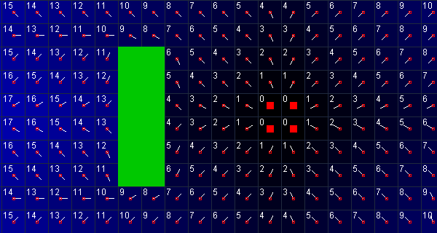
Potential fiels

Slide 5
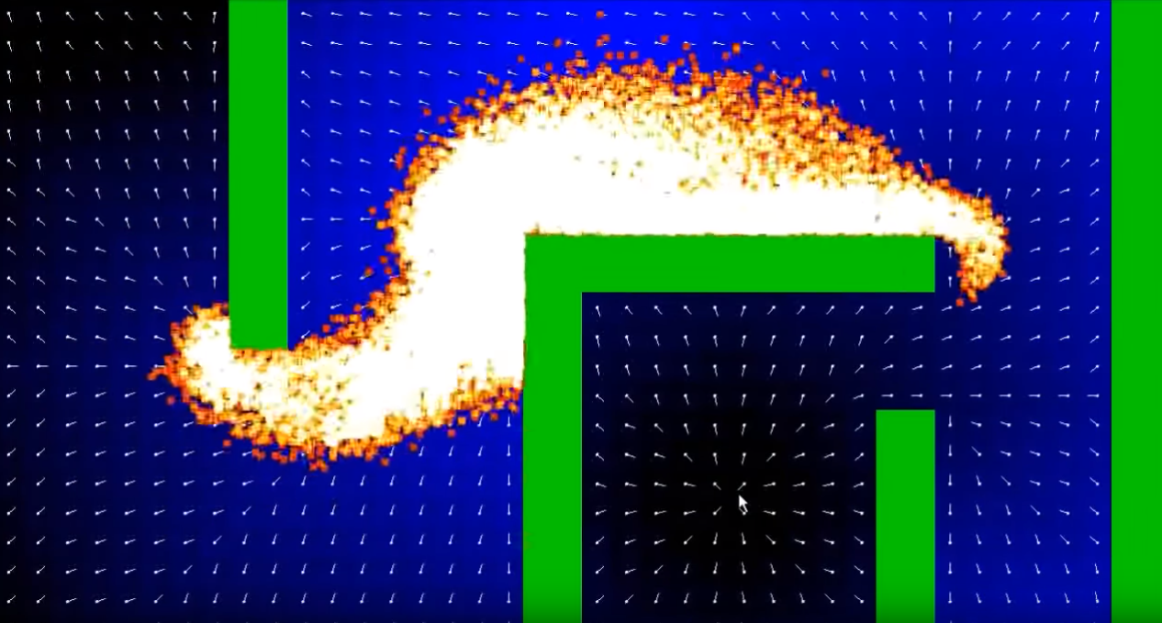
Potential fiels

Slide 7
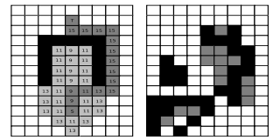
Swamps

Slide 8
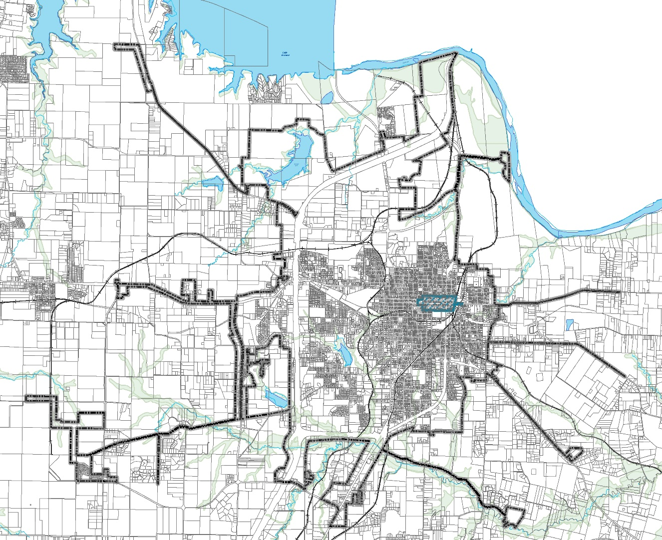
hierarchical pathfinding

Slide 9
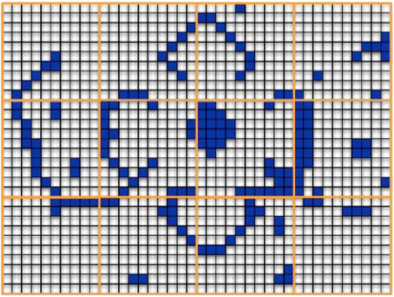
HPA*

Slide 10
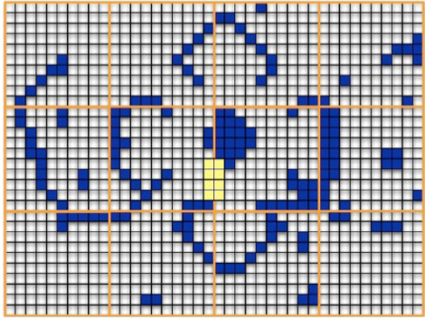
HPA*

Slide 11
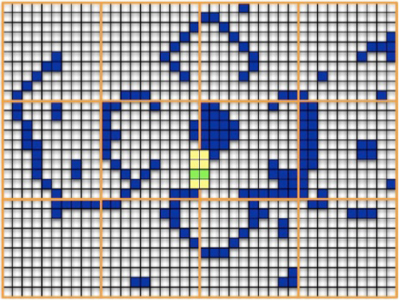
HPA*

Slide 12
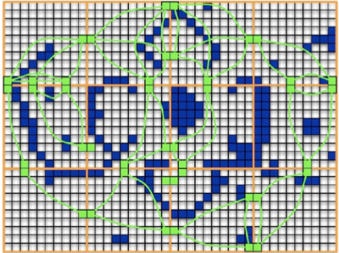
HPA*

Slide 13
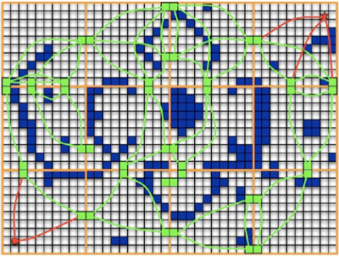
HPA*

Slide 14
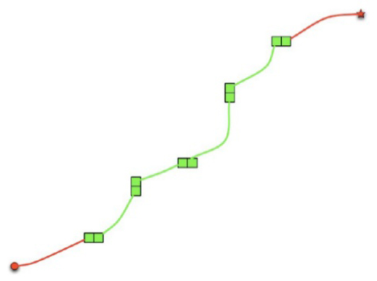
HPA*

Slide 15
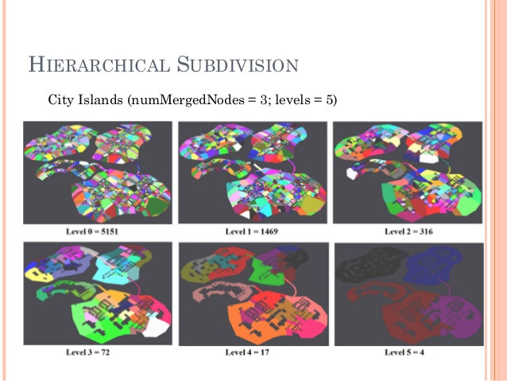
HPA*

Slide 16
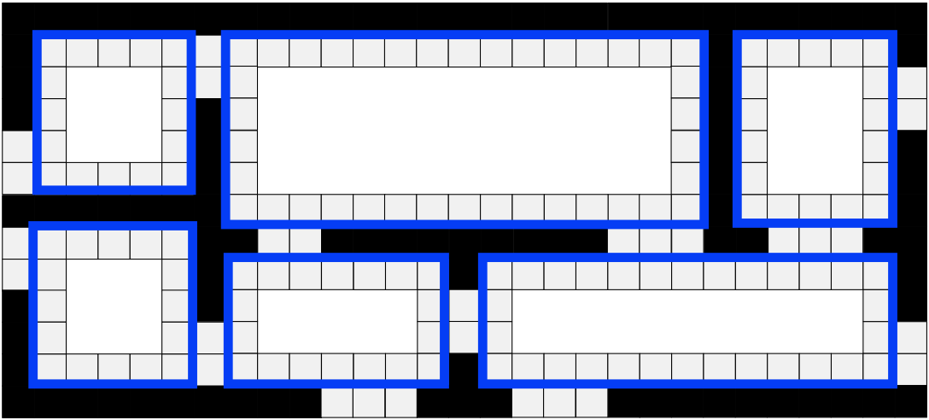
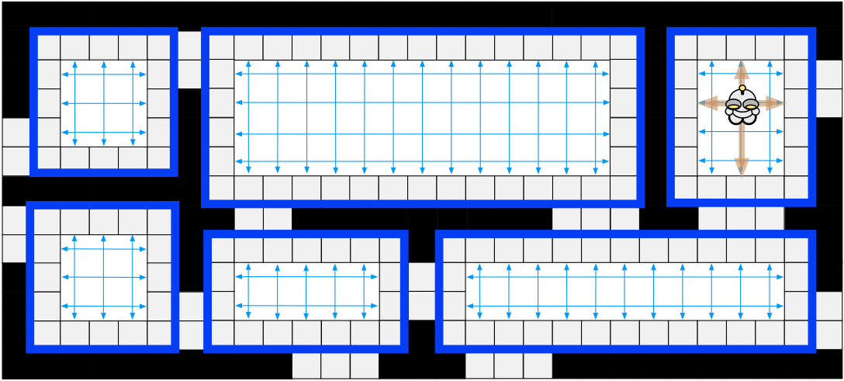
RSR

Slide 17
Selected approach

Slide 18

Jump point search

Slide 19
overview
Online
Incredibly Fast
Can be easily adapted with other improvement Algorythms
Only works with uniform-cost grids

Slide 20

objective

Slide 21
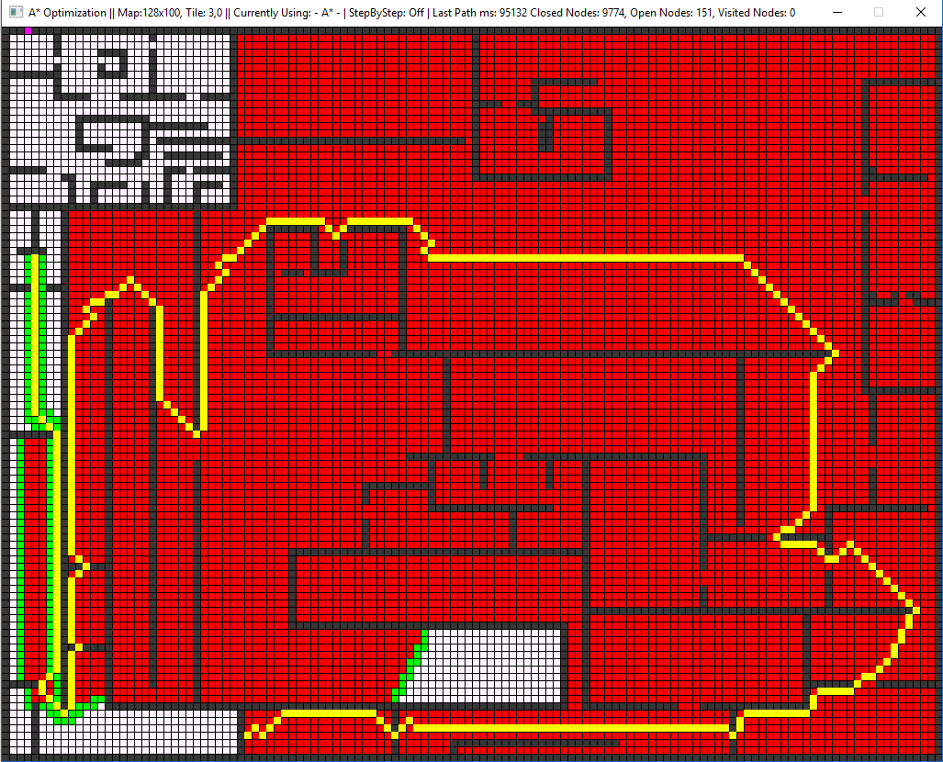
objective

Slide 22
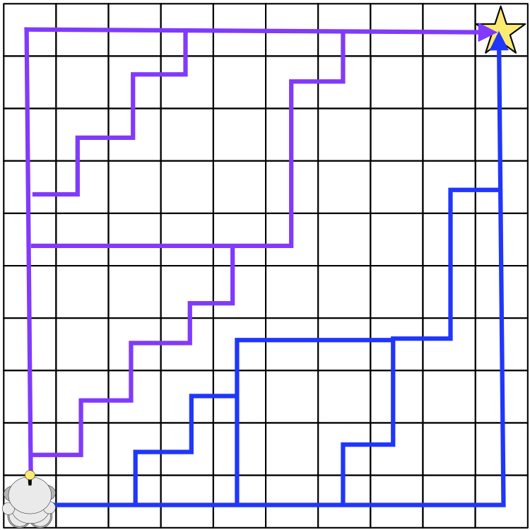
Path symmetry

Slide 23
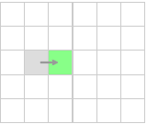
Horizontal jump

Slide 24
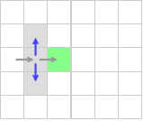
Horizontal jump

Slide 25
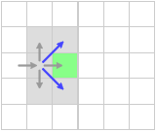
Horizontal jump

Slide 26
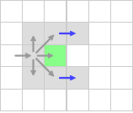
Horizontal jump

Slide 27
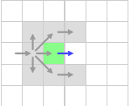
Horizontal jump

Slide 28
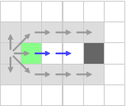
Horizontal jump

Slide 29
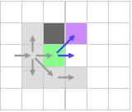
Horizontal jump – forced neighbour

Slide 30
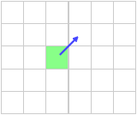
Diagonal jump

Slide 31
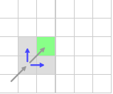
Diagonal jump

Slide 32
Diagonal jump

Slide 33
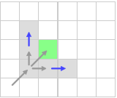
Diagonal jump

Slide 34
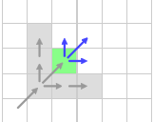
Diagonal jump

Slide 35
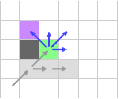
Diagonal jump - – forced neighbour

Slide 36
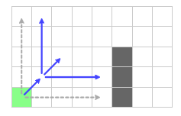
Iteration

Slide 37
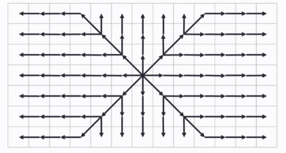
Iteration

Slide 38
Iteration
JPS == A*

Slide 39
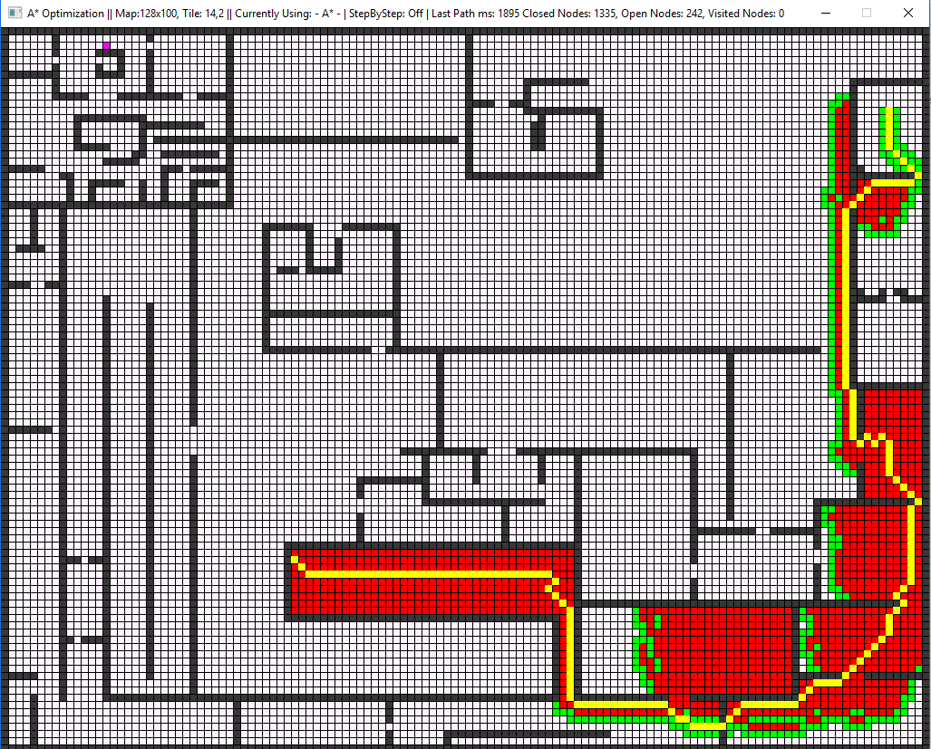
Performance

Slide 40
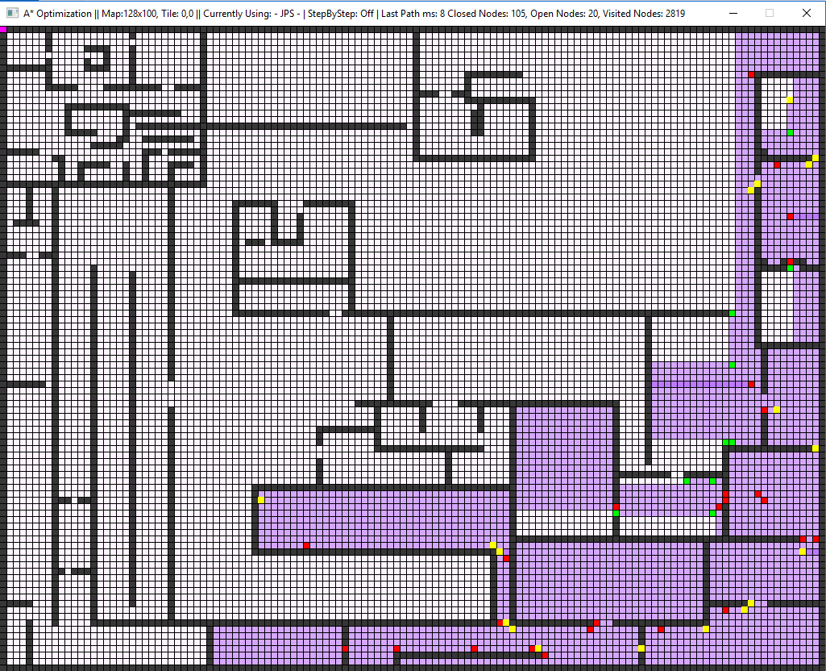
performance

Slide 41
Performance

Slide 42
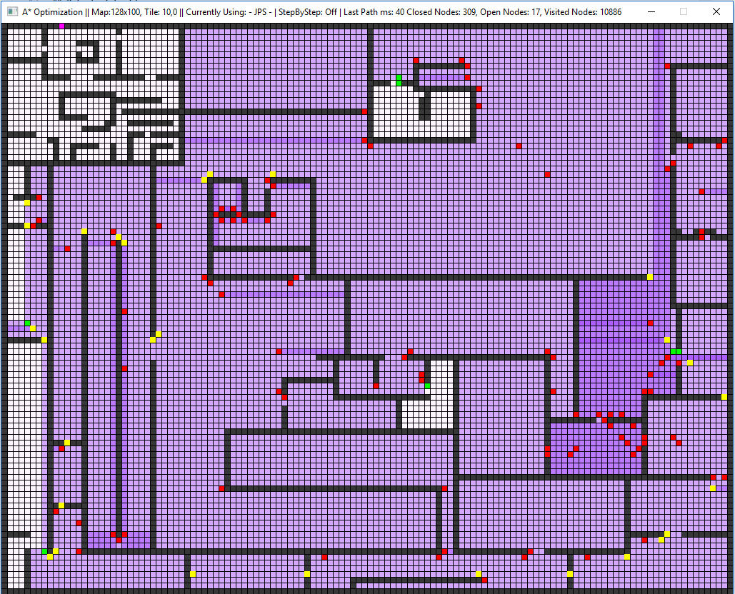
performance

Slide 43
Disclaimer!
this->JPS != JPS

Slide 44
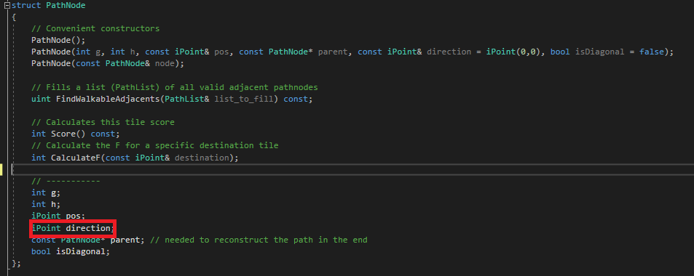
implementation

Slide 45
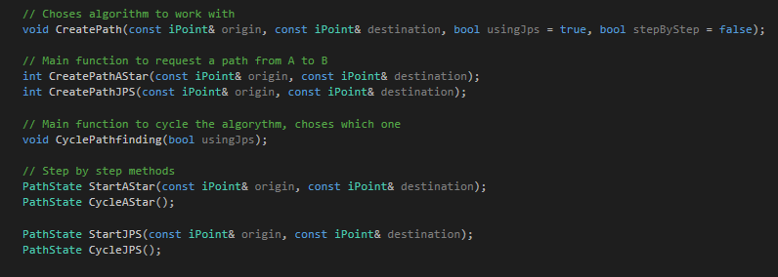
implementation

Slide 46
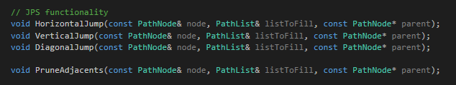
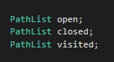
Implementation

Slide 47
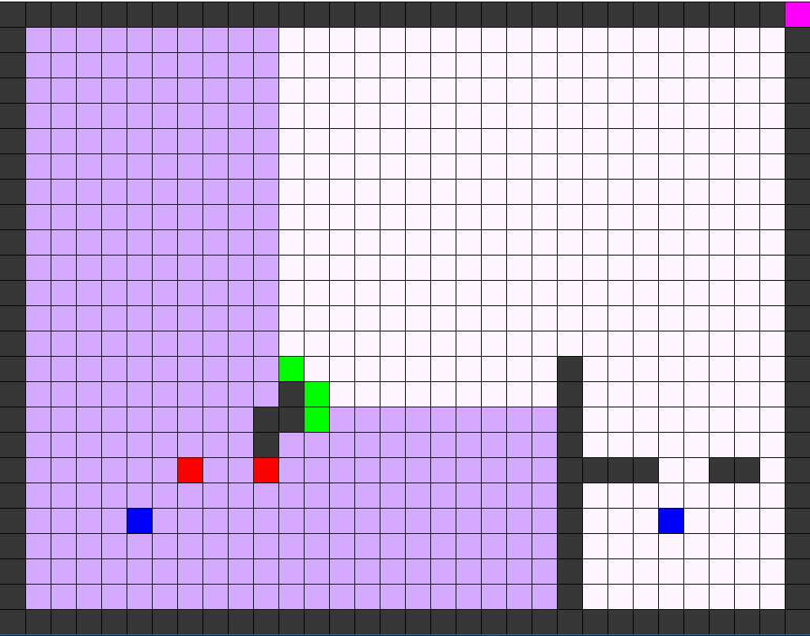
Debugging
F1 – CHANGE ALGORYTHM
F2 – SHOW DEBUG TILES
F3 – TOGGLE STEP BY STEP
Z – ZOOM IN / ZOOM OUT
S - STEPS
SPACE – FAST FORWARD STEPS

Slide 48
Let’s jump into it!

Slide 49
Todo 0
Add 8 different starting nodes, with the 8 possible directions to the open list

Slide 50
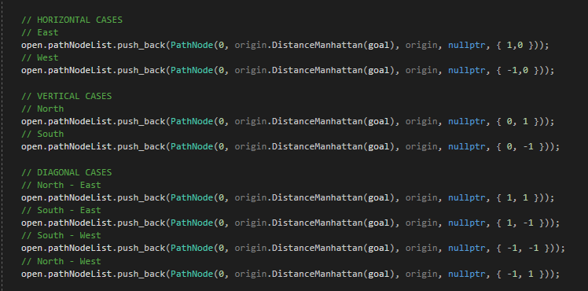
Todo 0 - Solution
Add 8 different starting nodes, with the 8 possible directions to the open list

Slide 51
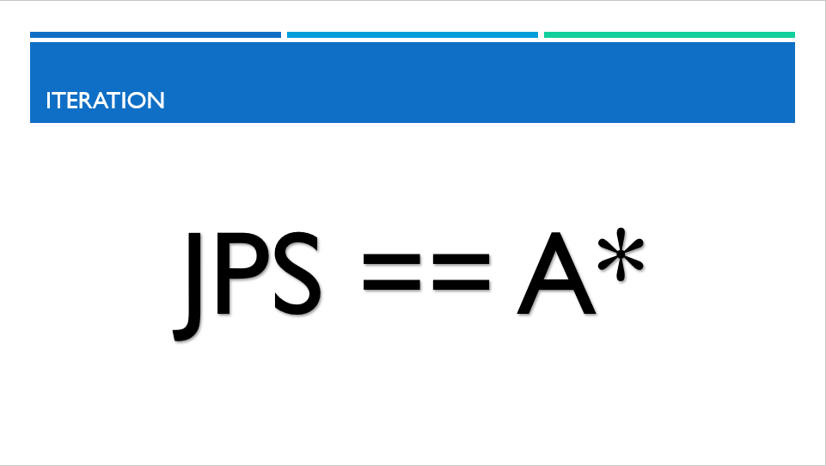
Todo 1
Fill the nieghbours list with the pruned neighbours.
Keep in mind that we do the same like in A*, only that we prune before adding elements

Slide 52
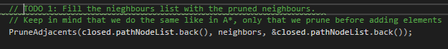
Todo 1 - Solution
Fill the nieghbours list with the pruned neighbours.
Keep in mind that we do the same like in A*, only that we prune before adding elements

Slide 53
TODO 2
Find any possible forced neighbour for an horizontal Jump. When we find one, we have to add it to the list to make sure its analyzed later on (with the proper direction), and we exit. Also, before we exit, don't forget to add the current propagation (as a node), so it can be completed and not forgotten

Slide 54
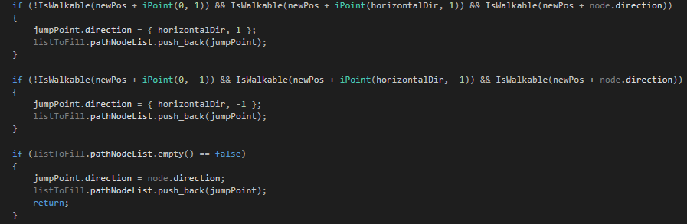
TODO 2 - Solution
Find any possible forced neighbour for an horizontal Jump. When we find one, we have to add it to the list to make sure its analyzed later on (with the proper direction), and we exit. Also, before we exit, don't forget to add the current propagation (as a node), so it can be completed and not forgotten

Slide 55
Todo 3
Really simple: if not found any forced neighbour, we just keep on jumping in the same direction as we are "coming from“. You have to make sure to return what that jump returns us

Slide 56
Todo 3
Really simple: if not found any forced neighbour, we just keep on jumping in the same direction as we are "coming from“. You have to make sure to return what that jump returns us

Slide 57
Todo 4
TODO 4: Make an horizontal jump with the proper direction. If it detected any forced neighbour, you have to add to the list the remaining directions that we are looking for (as nodes)so they don't get lost.

Slide 58
Improvements

Slide 59
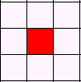
Not optimal
Each node is added multiple times to the open list
JPS handles all the pruning directions automatically

Slide 60

Missing path nodes

Slide 61
Starting loop

Slide 62
Corners traspassing

Slide 63
Thank you

